Slide 1


B.TECH PROJECT
Team Members
Supervised By
Mupparaju Hema varun - 21UEC064
Mr. Vikas Bajpai
Mallasani Harikrishna. - 21UCS121
Dr. Abhishek Sharma
Makkena Bharath Kumar - 21UCC061

Slide 2
Attention deficit hyperactivity disorder (ADHD) Detection Using Deep Learning

Slide 3

What is ADHD?
ADHD is one of the most common neurodevelopmental disorders of childhood. It is usually first diagnosed in childhood and often lasts into adulthood. Children with ADHD may have trouble paying attention, controlling impulsive behaviors (may act without thinking about what the result will be), or be overly active.

Slide 4

Signs And Symptoms
It is normal for children to have trouble focusing and behaving at one time or another. However, children with ADHD do not just grow out of these behaviors. The symptoms continue, can be severe, and can cause difficulty at school, at home, or with friends.
A child with ADHD might:
daydream a lot
forget or lose things a lot
talk too much
make careless mistakes or take unnecessary risks
have difficulty getting along with other

Slide 5
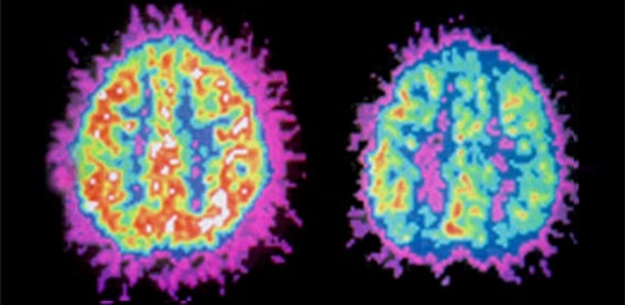
What Data Do We Need?
→ Activity patterns of brain regions is one such major difference found in people diagnosed with ADHD vs normal person. So we need Brain activity data, which is obtained through brain image scan.
→ Fmri scan Provides the brain activity of a person over a duration

Slide 6

Introduction to Nilearn
Nilearn is a powerful Python library for analyzing and visualizing neuroimaging data. It provides a versatile set of tools for preprocessing, modeling, and exploring brain imaging datasets, making it a valuable resource for neuroscientists and data scientists alike.

Slide 7
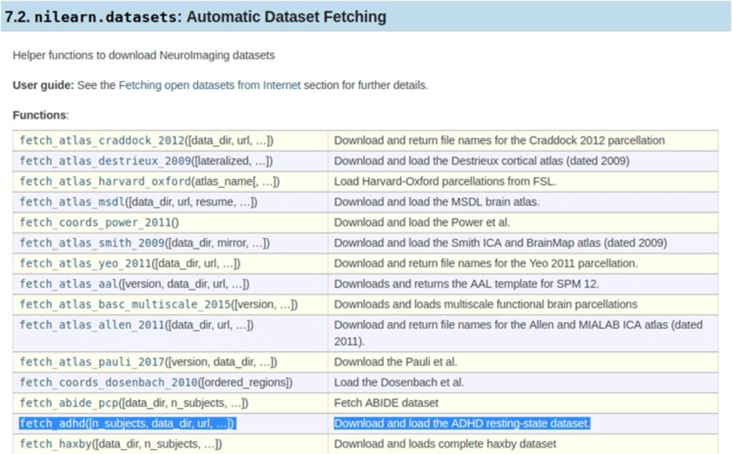
Get the dataset

Slide 8

1
Data Collection
We are using Nilearn ADHD Dataset
2
Extraction Of Time Series Data
Using Independent Component Analysis for FMRI Data
3
Training The Models
We created three models using Support Vector Machines, LSTM, Artificial Neural Networks
4
Hypothesis Testing
Analysing and Interpreting their results.

Slide 9

Preprocessing and cleaning data
Noise Reduction
1
Remove unwanted noise and artifacts from your brain images using nilearn's state-of-the-art denoising techniques.
2
Motion Correction
Align your images to compensate for head motion, ensuring that your analysis is not biased by subject movement.
Spatial Normalization
3
Transform your images to a common standard space, making it easier to compare results across subjects and studies.

Slide 10

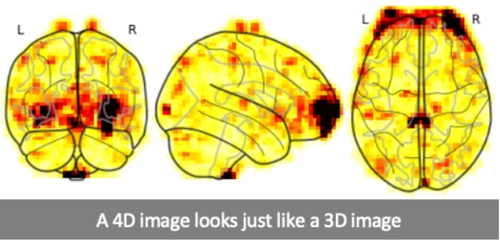
Visualizing a 4D Image
• When we have a 4D image, we can think of it as a series of 3D volumes.
• The first 3 dimensions in this represents space(or axes as in x, y, z) whereas 4th is time.
• If we fix values for these first three axes, you have given me a coordinate in the first three axes of the array which is called a “Voxel”.
• For example, we fix values for the first three axes like this: (30, 32, 25) in an example image of one subject.

Slide 11

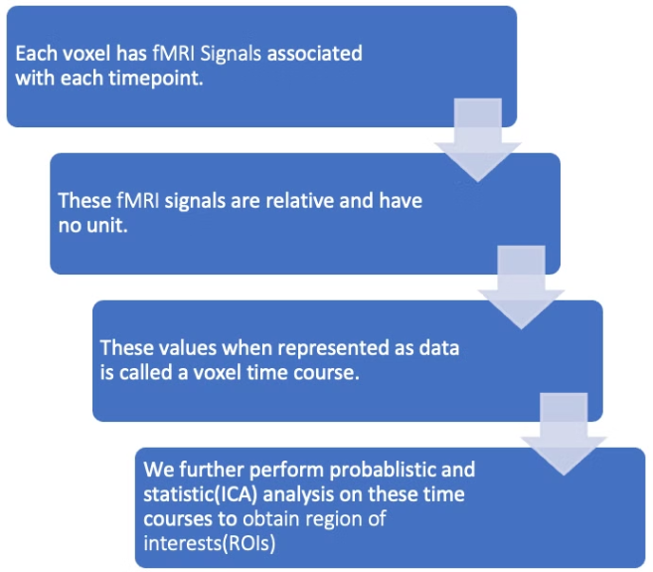
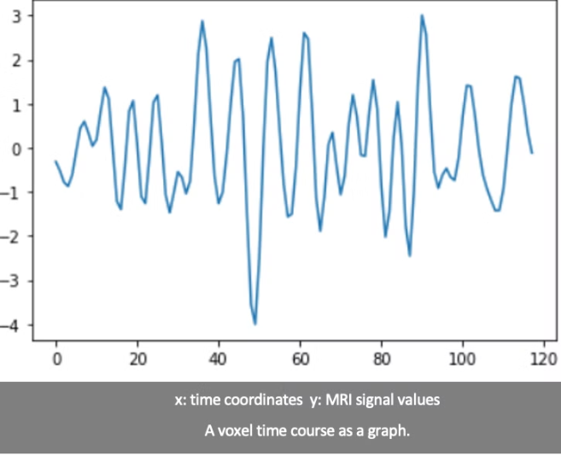
What is voxel Time-series?

Slide 12
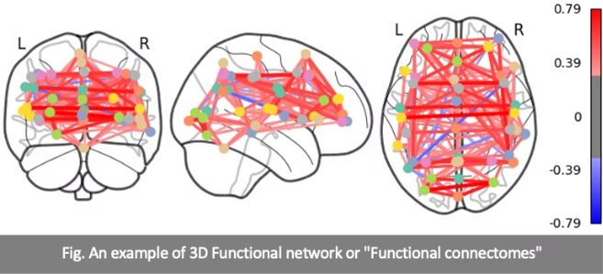
DATA PROCESSING STEPS FOR FEATURE SELECTION
• Nilearn method CanICA to perform ICA(Independent Component Analysis)
• Extracting time-series for ROIs and measuring functional connectivity
• Functional connectivity shows how brain regions connect with one another and make up functional networks.
• Obtaining functional connectivity in the form of correlation matrices.

Slide 13
Independent Component Analysis (ICA)
In this step, we use the built-in canICA function present in the Nilearn library to find out independent networks present in the brain map.
Tasks in our day-to-day lives involve different actions that require different parts of the brain to perform.
So, we need to identify those different regions in the brain that contribute towards the different actions which contribute to our daily lives.

Slide 14

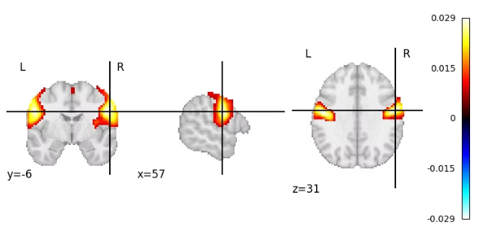
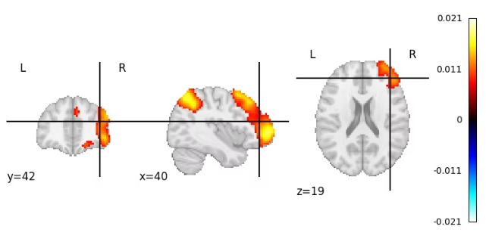
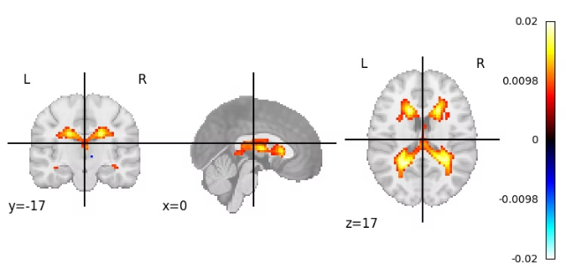
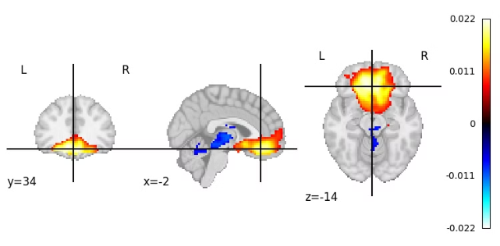
Independent Component Analysis(ICA)

Slide 15

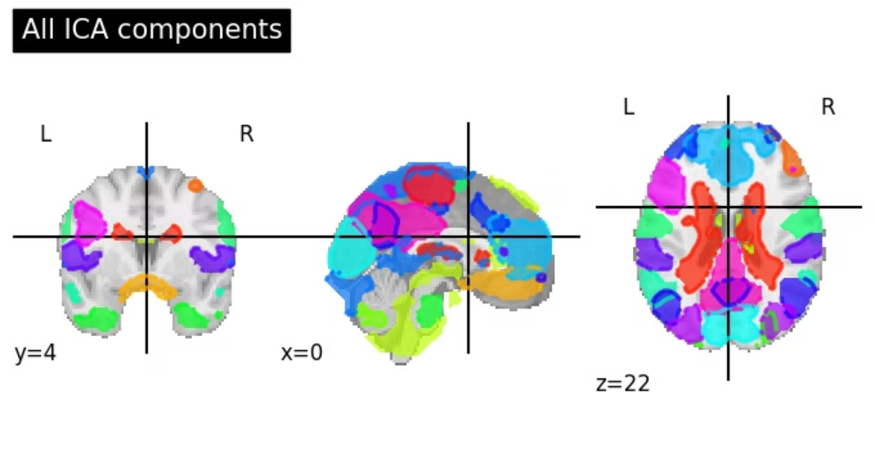
Independent Component Analysis (ICA)

Slide 16

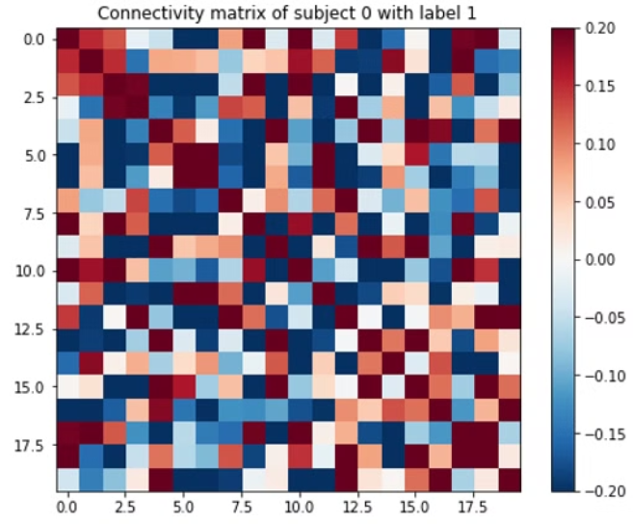
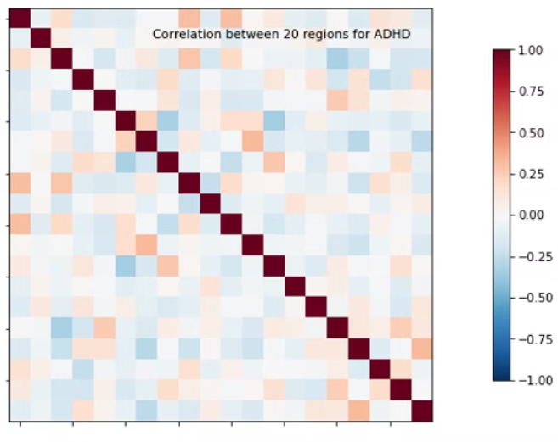
Functional Connectivity
Mean correlation matrix for functional connectivity - ADHD
Correlation matrix for functional connectivity - ADHD

Slide 17
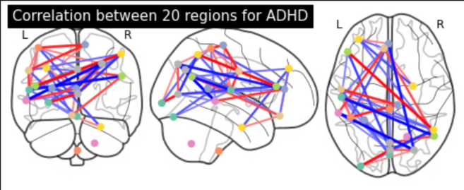
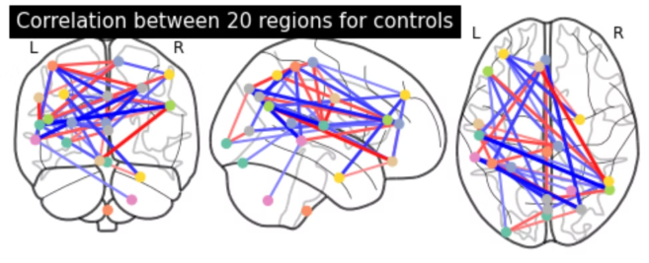
Functional Connectivity Over Brain
correlation between regions specified using canICA method for ADHD subjects.
correlation between regions specified using canICA method for non ADHD subjects

Slide 18
LSTM MODEL
Long short-term memory (LSTM) models provide some benefits in learning fMRI data. The main reason is that, unlike most machine learning or deep learning methods, they manage to keep the contextual information of the inputs — thus incorporate details from previous parts of the input sequence while processing a current one
There are cases where LSTMs are not the best choice; being contextual could lead to an over-interpretation of the data. In addition, LSTMs could take longer to run than a simple NN and they might have far more parameters to tune. It is important to consider various options and finding the most suitable model from the relevant scenario

Slide 19
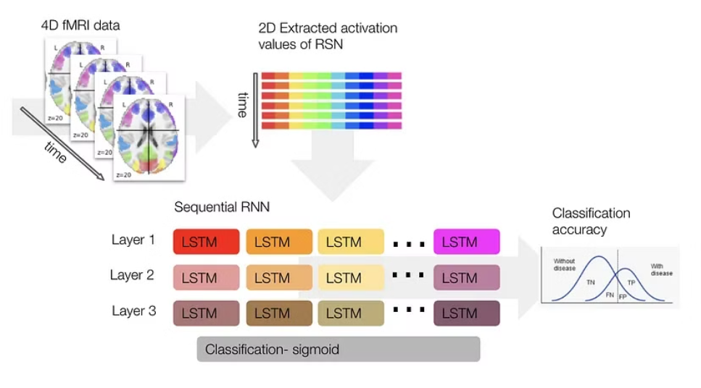
WHY LSTM ?
The ability of LSTMs in analyzing fMRIs due to their contextual nature.
fMRI data represents dynamic brain activity over time, thus using LSTMs enables taking advantage of the temporal information (that otherwise would have been lost) when analyzing functional connectivity

Slide 20

ISSUES WITH LSTM
An issue with LSTMs is that they can easily overfit training data, reducing their predictive capacity
SOLUTIONS
A solution to this problem is via regularization, which hinders the model’s overfitting tendency.
A conventional regularization in LSTM networks is the dropout, which probabilistically excludes units from the layer connection
There are two types of dropouts- input dropout and recurrent dropout.
A dropout on the input means that for a given probability, the data on the input connection to each LSTM unit will be excluded from node activation and weight updates (see the dropout argument). The dropout on the recurrent input acts the same way but on the recurrent connection (see the recurrent_dropout argument).
However, it is important not to over-regularize as it will hinder the model from learning at all (which could be detected by strict non-indicative prediction).

Slide 21

HOW DROPOUT PREVENTS MODEL FROM OVERFITTING ?
In dropout, some neurons are randomly "dropped out" or turned off during the training process, effectively reducing the complexity of the model. This helps to prevent overfitting and encourages the model to learn more robust and general features. The dropout rate is the fraction of neurons that are dropped out, and it is a hyperparameter that is set by the practitioner.
Dropout has been shown to be an effective regularization technique for LSTMs, particularly in sequential data, where overfitting is a common problem. By applying dropout to the recurrent connections within an LSTM cell, the model can better handle the large amounts of data that are typically encountered in sequential data problems
However it is important not to over regularize as it will hinder the model from learning at all as it leads to the case of underfitting.

Slide 22

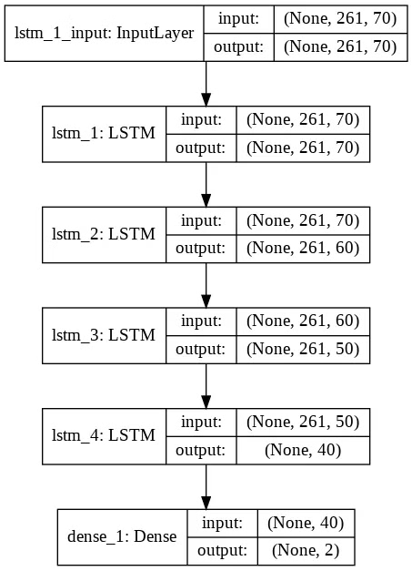
Hyper Parameters Tuning
The model we present here is a sequential model with three stacked LSTM layers and one dense layer with sigmoid activation. To be frank, there is no one right answer to how one chooses their hyperparameters. There is a lot of trial and error and rules of thumb.
We present a few that we have done :
Generally, we would like to have at least two hidden layers (not including the last layer) since the power of NNs stems from their depth (i.e., a zero-layer can only represent linear functions..). Yet there is a trade-off between accuracy and training time — find the number of layers that add significant value to the accuracy without costing too much time

Slide 23
Number of layers of each type and Number of Nodes in each layer :
Every NN has three types of layers: input, hidden, and output.
1) INPUT LAYER :
Every neural network has one Input layer , Specifically, the number of neurons comprising that layer is equal to the number of features (columns) in your data. Some NN configurations add one additional node for a bias term.
2) OUTPUT LAYER :
Like the Input layer, every NN has exactly one output layer , If the NN is a regressor, then the output layer has a single node. If the NN is a classifier, then it also has a single node unless softmax is used in which case the output layer has one node per class label in your model.

Slide 24
3) Hidden Layer :
Likely to have at least two hidden layers excluding the output layer because the power of the neural networks stems from their depth
Deciding the number of neurons in the hidden layers is a very important part of deciding your overall neural network architecture. Though these layers do not directly interact with the external environment, they have a tremendous influence on the final output
Using too few neurons in the hidden layers will result in something called underfitting. Underfitting occurs when there are too few neurons in the hidden layers to adequately detect the signals in a complicated data set
Using too many neurons in the hidden layers can result in several problems. First, too many neurons in the hidden layers may result in overfitting.

Slide 25
Overfitting occurs when the neural network has so much information processing capacity that the limited amount of information contained in the training set is not enough to train all of the neurons in the hidden layers.
Even when the training data is sufficient. An inordinately large number of neurons in the hidden layers can increase the time it takes to train the network. The amount of training time can increase to the point that it is impossible to adequately train the neural network.
RULE OF THUMB IN DETERMINING NUMBER OF NEURONS IN HIDDEN LAYER :
should be between the size of the input layer and the size of the output layer.
should be 2/3 the size of the input layer, plus the size of the output layer.
should be less than twice the size of the input layer.

Slide 26
The output layer activation is mostly sigmoid for binary classification, softmax for a multi-class classifier, and linear for regression.
The classification loss function should be matched to the number of labels and their type. The binary_crossentropy loss function is best for binary classification, the categorical_crossentropy is great for multiclass with or one-hot-encoded data and sparse_categorical_crossentropy for integer-like labels.
The accuracy metric is great to show the percent of correct classifications. You can use more than one!
The more epochs the better, start with 30 and follow your validation set for a decreasing loss and improvement in the accuracy. If you see improvement, increase the number of epochs, otherwise — go back to the drawing board.

Slide 27

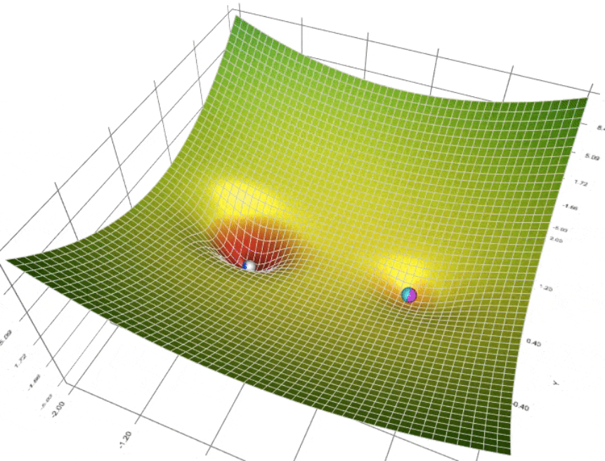
OPTIMIZER :
Optimizers in machine learning are used to tune the parameters of a neural network in order to minimize the cost function.
🟢 => RMSPROP🔵=> ADAM ⚪=>ADAGRAD 🟣=>Gradient Descent SkyBlue=>Nesterov Accelerated Gradient (NAG)

Slide 28
We are not choosing Gradient Descent Optimizers because :
Learning rate tuning problem: all of them are subjected to the choice of a good learning rate. Unfortunately, this choice is not straighforward.
Not good for sparse data: there is no mechanism to put in evidence rarely occurring features. All parameters are updated equally.
High possibility of getting stuck into a suboptimal local minima.
We are Choosing ADAM OPTIMIZER for our model :
Adam is the best among the adaptive optimizers in most of the cases.
Good with sparse data: the adaptive learning rate is perfect for this type of datasets.
There is no need to focus on the learning rate value

Slide 29
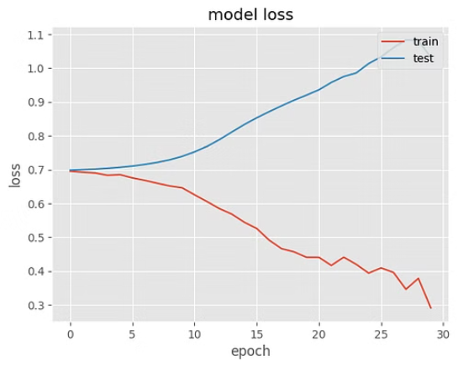
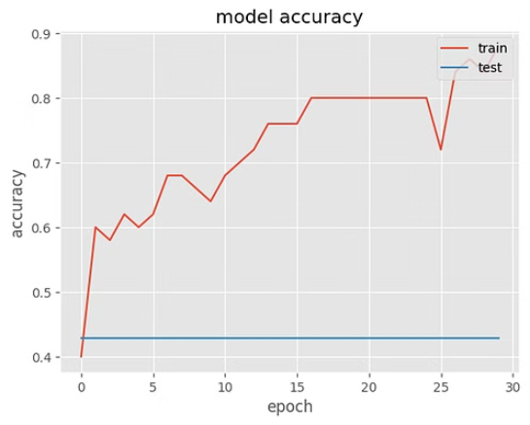
LSTM MODELS ACCURACY AND LOSS
We see some increase in the model’s accuracy and some decrease in the model’s loss as the number of epochs increases.
Additionally, both the training and validation sets showing similar trends.
Thus, we are (1) having a working model and
(2) probably not overfitting

Slide 30

Hypothesis Testing
We have used a hypothesis testing framework to evaluate the model since it helps obtain both the accuracy of the model and its significance. To calculate the model’s significance, we used bootstrapping. Bootstrapping, shortly, is a powerful, computer-based method for statistical inference without relying on too many assumptions. It helps us approximate the properties of the population by estimates from small data samples.
Bootstrap resampling is rooted in the principle of using the data itself to estimate the sampling distribution of a statistic. This technique involves repeatedly drawing samples, with replacement, from the observed dataset and calculating the statistic of interest for each sample.The collection of these statistics forms an empirical distribution that approximates the true sampling distribution of the statistic under the null hypothesis

Slide 31
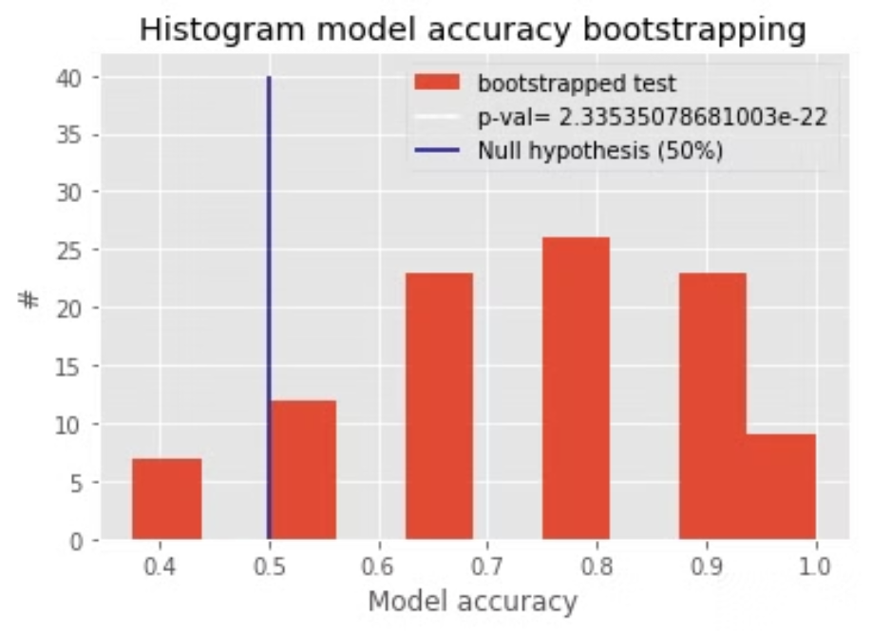
NULL HYPOTHESIS : there are no differences between ADHD patients to controls ALTERNATIVE HYPOTHESIS : there are differences between ADHD patients to controls

Slide 32

To evaluate this hypothesis, we will repeatedly resample with replacement from the data; splitting it into a train and test parts, fitting the model, predicting the labels of test data, and calculating the accuracy. Such repetition will create a distribution of accuracies. Such resampling (following the central limit theorem) is likely to approach a Gaussian shape the larger the number of iterations we use. Thus, we could employ statistical tests that require normal distribution (like t-test).
If 0.5 placed at the tails of the distribution (i.e at the last 5%), we can conclude that it is very unlikely that the distribution is centered around 0.5 and reject the null hypothesis. Otherwise, we would fail to reject it.

Slide 33

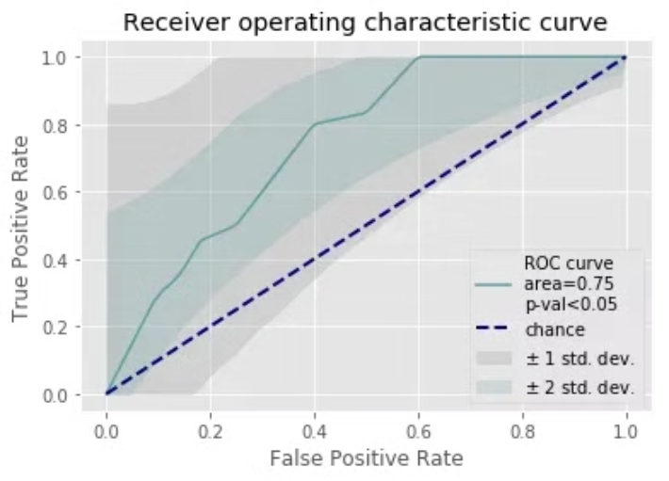
ROC CURVES OF THE MODEL
The ROC curve seen above shows a significant above-average classification capacity. We see that the median value, as well as one SD around it, is fully placed above the chance diagonal. The 95% confidence intervals (presented by 2 SD around the mean ROC curve expands below the chance diagonal mostly at the bottom left point. This could mean that the model is more likely to express higher sensitivity but lower specificity.

Slide 34
The model’s sensitivity is the proportion of patients that were identified correctly to have the disease (i.e. True Positive) upon the total number of patients who actually have the disease. The model’s specificity describes the proportion of patients that were identified correctly to not have the disease (i.e. True Negative) upon the total number of patients who do not have the disease. Usually, these two display an inverse relation.
Sensitivity or specificity?
It depends. However, it is common in diagnostic experiments to favor sensitivity- thus not missing any actually ill patients (and risking falsely diagnosing healthy patients). However, such a decision is highly related to the nature of the hypothesis

Slide 35

Overview of Artificial Neural Networks (ANNs)
What are ANNs?
Applications of ANNs
Advantages of ANNs
An Artificial Neural Network (ANN) is a simplified model of the brain, mimicking its structure with interconnected processing units called neurons, which learn to perform specific tasks by adjusting the strength of their connections during the training process. ANNs excel at recognizing patterns, extracting features, and making predictions from complex, nonlinear data.
ANNs have been successfully applied to a wide range of domains, including image recognition, natural language processing, speech recognition, and medical diagnosis. Their ability to learn from data and generalize to new, unseen examples makes them particularly well-suited for tasks where traditional algorithms may struggle, such as the analysis of fMRI data for ADHD detection.
ANNs can effectively handle noisy or incomplete data, making them a powerful tool for processing and analyzing complex neuroimaging data. Additionally, they can learn to extract relevant features from the data, reducing the need for manual feature engineering, which is often a time-consuming and subjective process.

Slide 36

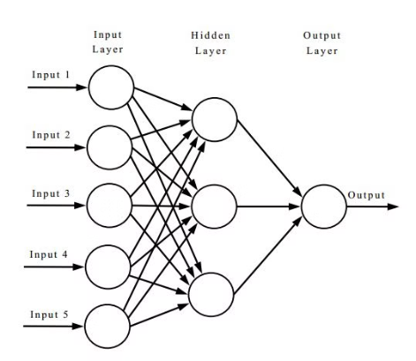
IMPLEMENTATION OF ANN:
Input Layer:
Dense with # neurons = # features / 2 (captures basic features).
Hidden Layers:
Iterative Dense layers with ReLU activation (reduces neurons by half each layer, extracts higher-level features).
Perform complex computations and feature extraction often one or more.
Minimum 4 neurons in final hidden layer.
This prevents from overfitting and to simplify the model
Output Layer:
Dense with 2 neurons (binary classification).
Sigmoid activation (probability output between 0-1).

Slide 37
Advantages of Categorical Cross-Entropy
Intuitive Interpretation
Sensitivity to Probabilities
Multiclass Support
Categorical cross-entropy has a clear and intuitive interpretation as the negative log-likelihood of the true class labels, making it easy to understand and reason about.
Categorical cross-entropy seamlessly extends to multiclass classification problems, making it a versatile choice for a wide range of deep learning applications.
Unlike other metrics like accuracy, categorical cross-entropy is sensitive to the model's predicted probabilities, providing more granular feedback for model optimization.

Slide 38
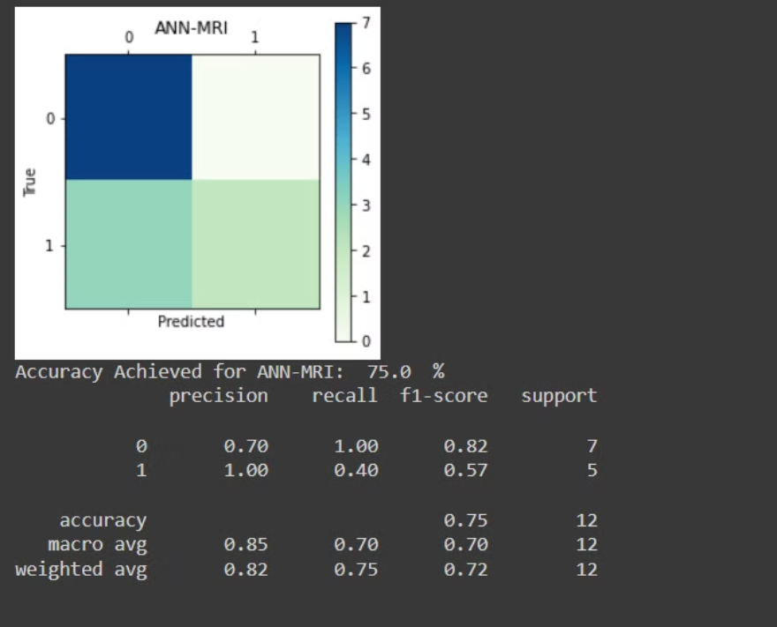
ACCURACY FROM ANN MODEL :
we can clearly see that accuracy of predicting the person having ADHD is high the the predicting the person having no ADHD.

Slide 39
Selecting the Optimal SVM Kernel
RBF Kernel
Other Kernels
Grid Search
The Radial Basis Function (RBF) kernel is a popular choice for SVM as it can handle non-linear decision boundaries effectively.
Linear, Polynomial, and Sigmoid kernels may also be considered, but the RBF kernel often outperforms them for complex datasets.
By testing a range of kernel types and tuning the kernel parameters, we can determine the optimal kernel configuration for the given problem.

Slide 40
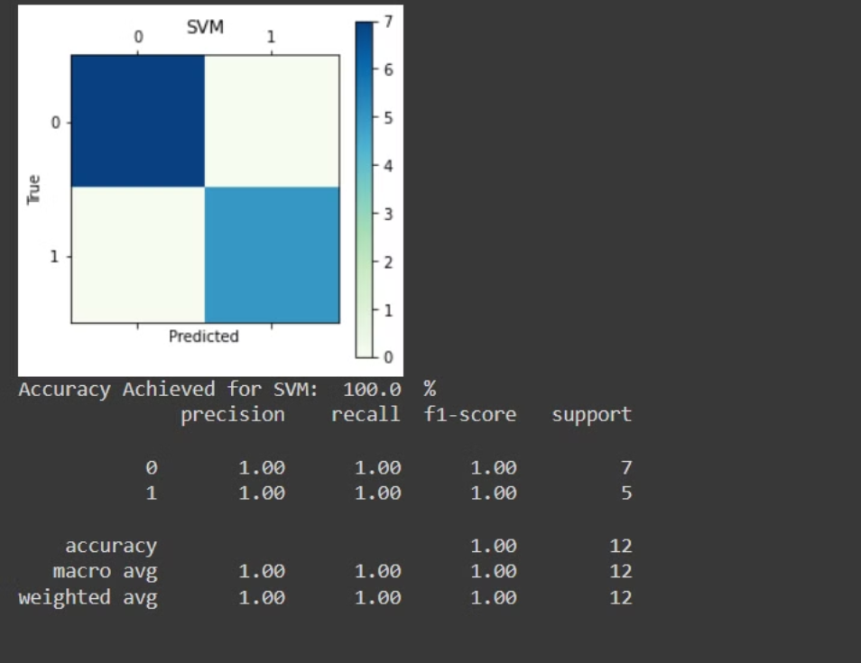
ACCURACY FROM SVM MODEL :

Slide 41

Combining ANN and SVM models for ADHD detection
Ensemble Prediction Function:
1)The function takes predictions from two models, along with a weight vector and an optional threshold value.
2) It calculates the weighted sum of the predictions from both models.
3) Then, it applies a threshold to the combined prediction to determine the final prediction.
4)Finally, it returns the ensemble prediction as a list.
Thresholding:
1) Each element in the combined prediction c is compared to the threshold value (0.5 by default).
2) If the value exceeds the threshold, the corresponding prediction is set to 1, indicating the positive class.
3) Otherwise, it is set to 0, indicating the negative class.

Slide 42
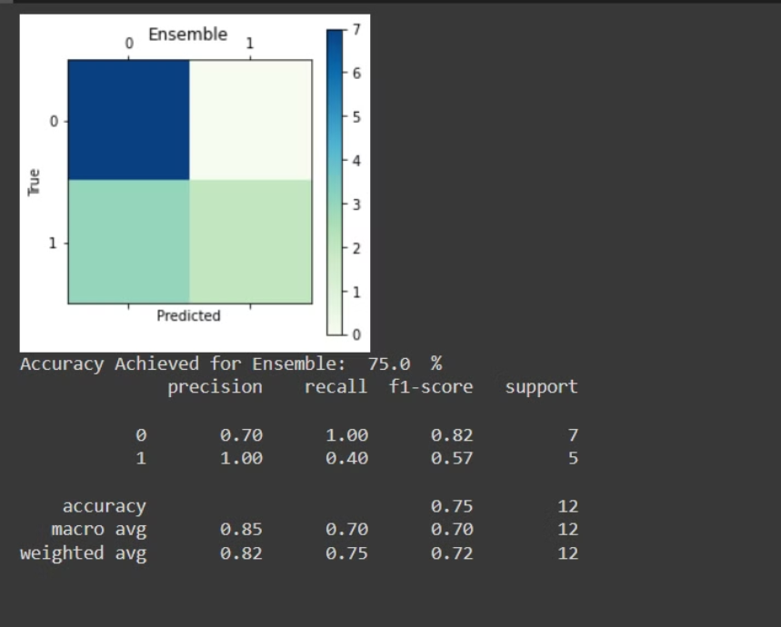
ENSEMBLED MODEL USING ANN and SVM:
ACCURACY OBTAINED:

Slide 43
Summary
Imported Raw Data
Preprocessing the Data
Performing Independent Component Analysis (ICA)
Extracting Time Series Data
Data Preparation for training and testing the model
Built LSTM MODEL
Built the Ensembled Model Of ANN and SVM

Slide 44

References :
1) https://www.nitrc.org/frs/?group_id=383
2) http://nilearn.github.io/user_guide.html
3) http://fcon_1000.projects.nitrc.org/indi/adhd200/
4) https://www.humanconnectome.org/study/hcp-young-adult/document/extensively-processed-fmri-data-documentation

Slide 45

Team :
1) Makkena Bharath - 21ucc061
2) Hemavarun Mupparaju - 21uec064
3) Mallasani Harikrishna - 21ucs121
Thank You !!

